Slide 1
数字信号处理第八九十章习题课

Slide 2
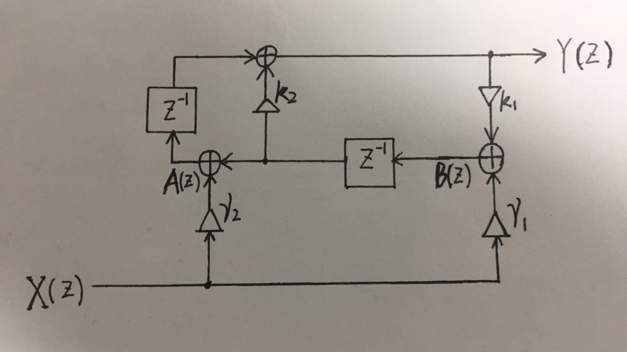
8.5 Solution

Slide 3
8.5 Solution

Slide 4
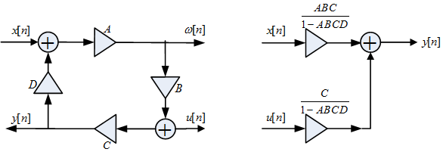
8.11 Solution

Slide 5
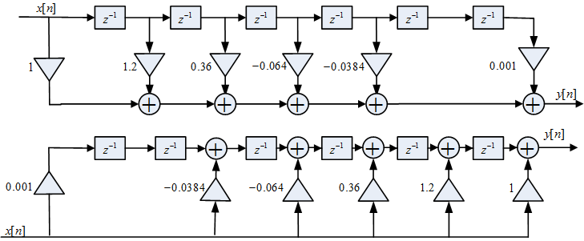
8.13 Solution

Slide 6
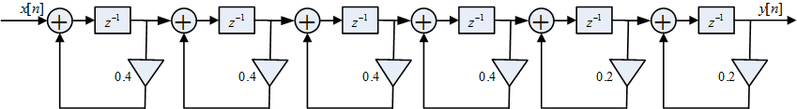
8.13 Solution
8.25 Solution

Slide 7
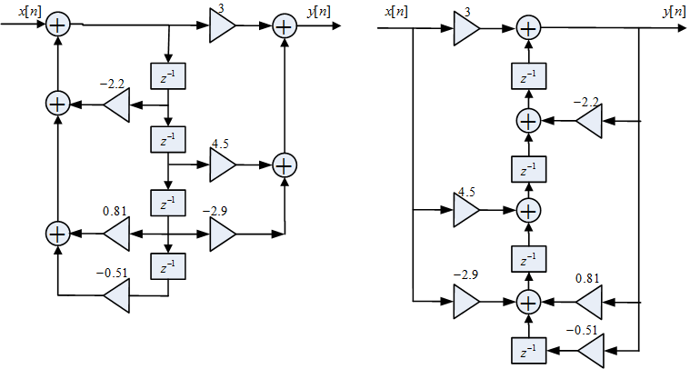
8.25 Solution
注：图中系数-0.51应为-5.1

Slide 8
8.28 Solution

Slide 9
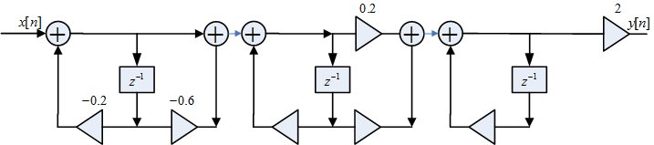
8.28 Solution

Slide 10
9.2 Solution

Slide 11
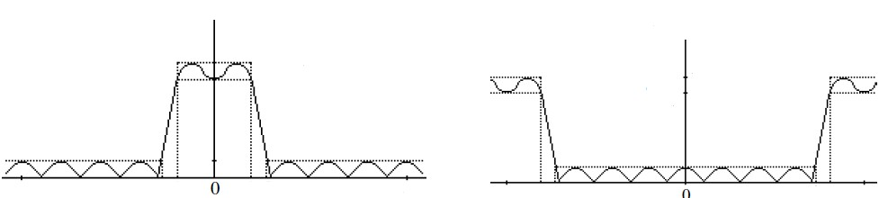
9.4 Solution

Slide 12
9.9 Solution

Slide 13
9.10 Solution

Slide 14
9.11 Solution

Slide 15
9.12 Solution

Slide 16

9.14 Solution

Slide 17
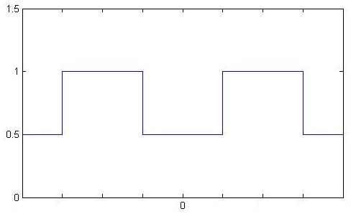
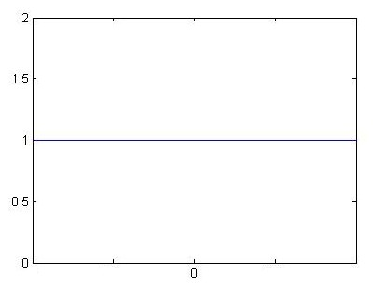
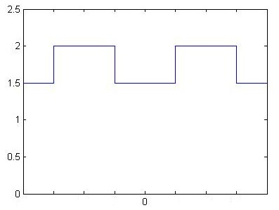
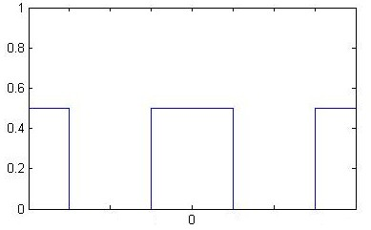
9.16 Solution
So,

Slide 18
9.30 Solution

Slide 19
9.30 Solution

Slide 20
10.1 Solution

Slide 21
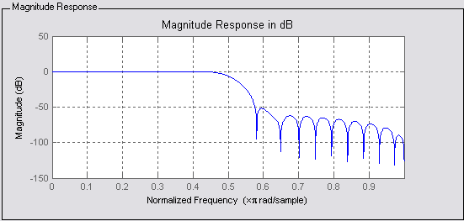
10.17 Solution

Slide 22
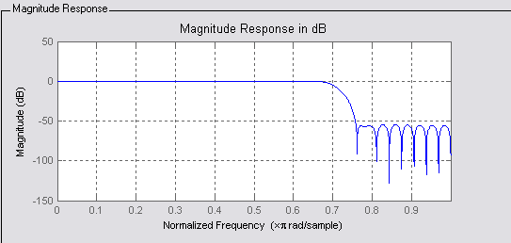
10.17 Solution

Slide 23
10.30 Solution
(a)

Slide 24
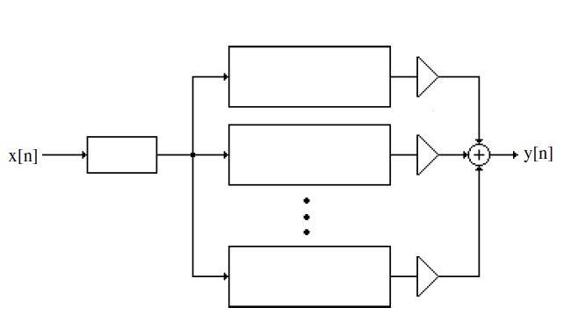
10.30 Solution
(b)

Slide 25
10.30 Solution
(c)

Slide 26
10.31 Solution
(a)

Slide 27
10.31 Solution
(b)

